Slide 1
GRAPH ALGORITHM VISUALIZATION
Arpit Patel, Devayan Mandal, Ikhlas Ahmed, Khaled Alhammad
CSC 507 Software Engineering
Professor James Teresco
Professor Kimberly Gero
3/29/2016

Slide 2
INTRODUCTION
Incremental Approach
Web based mapping system
Web site is usable for both client and end-user
Its mainly focused for undergrad student, who can learn how the algorithm works
Efficiency: End user can easily upload the algorithm data file to the visualization website
Minimal learning curve for the end user

Slide 3
technologies
Front End:
HTML
CSS
JavaScript
Back End:
Java
Server:
WinSCP
Mogul

Slide 4
VERSIONS
Current Project
Very basic User Interface
Co-ordinates table was not aligned
Result was shown above the map and was not clear

Slide 5
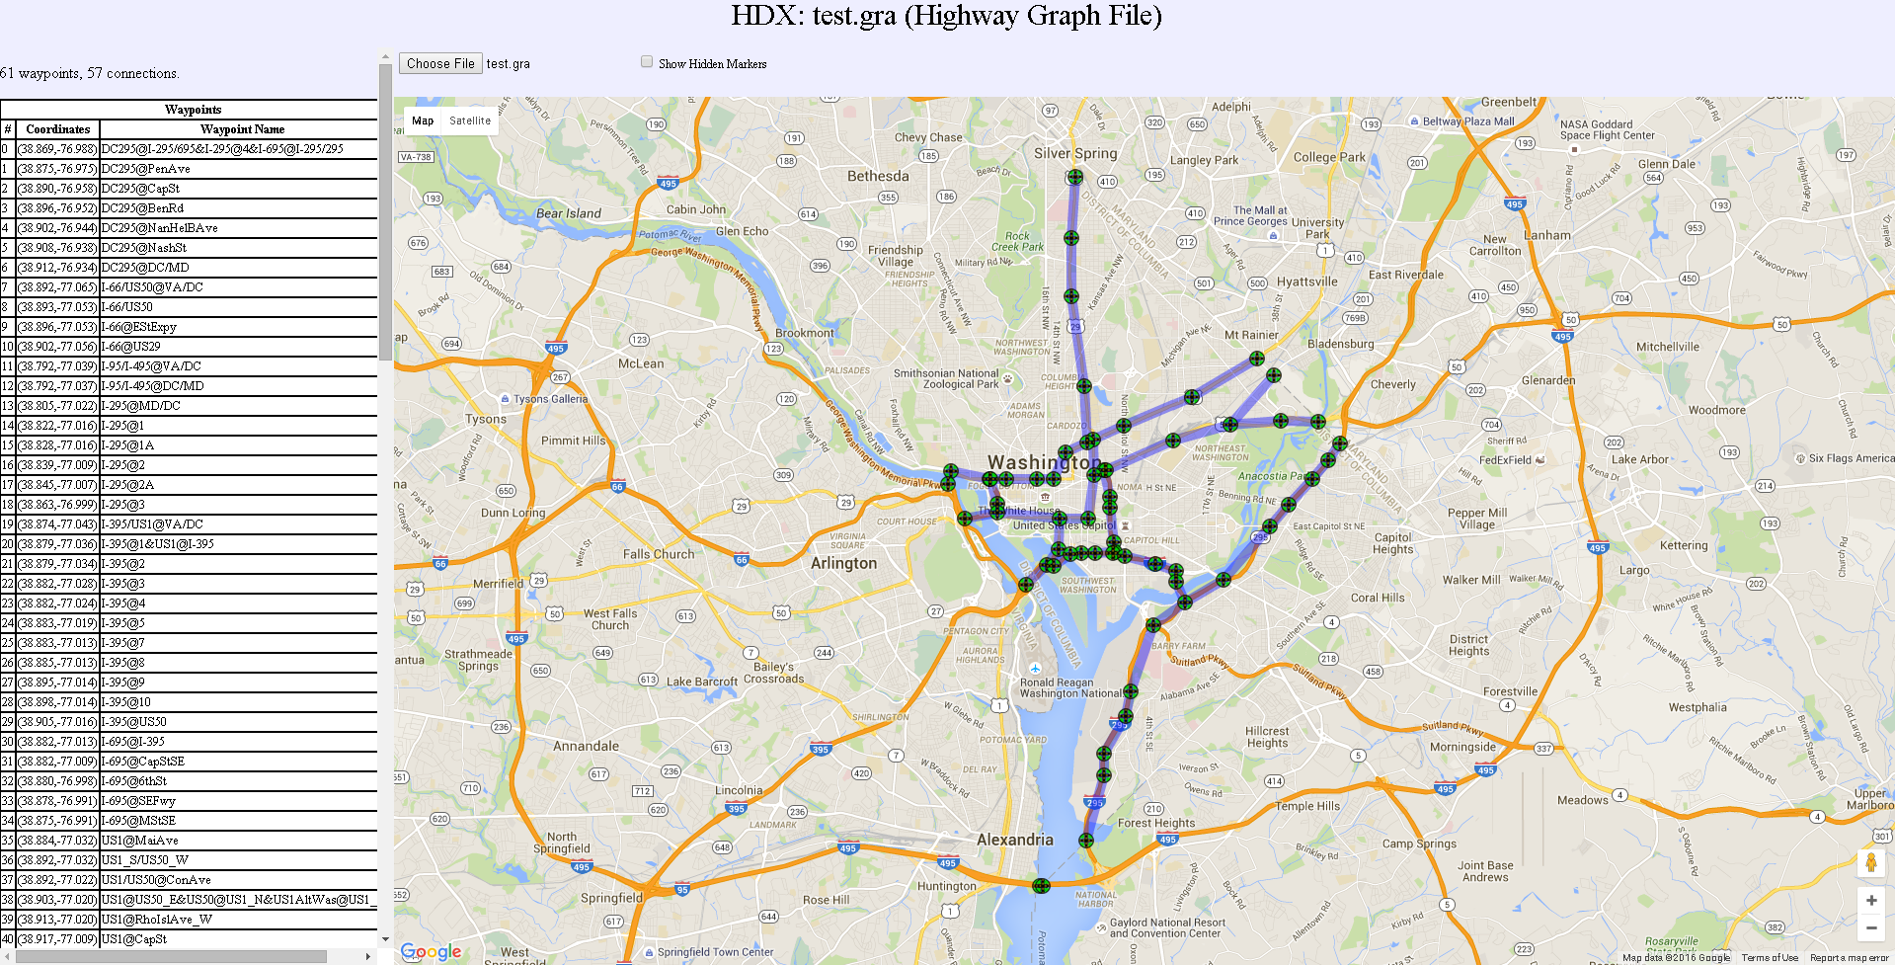
Screen shots

Slide 6
Newer Version
Improved User Interface
Selection box and button are aligned
Table is formatted with appropriate font size
Table and map is separated for the ease of access
The results of the algorithm search are displayed above the co-ordinates table

Slide 7
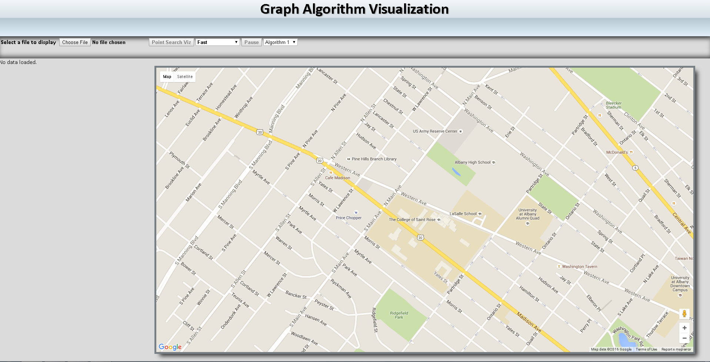
Screen shots

Slide 8
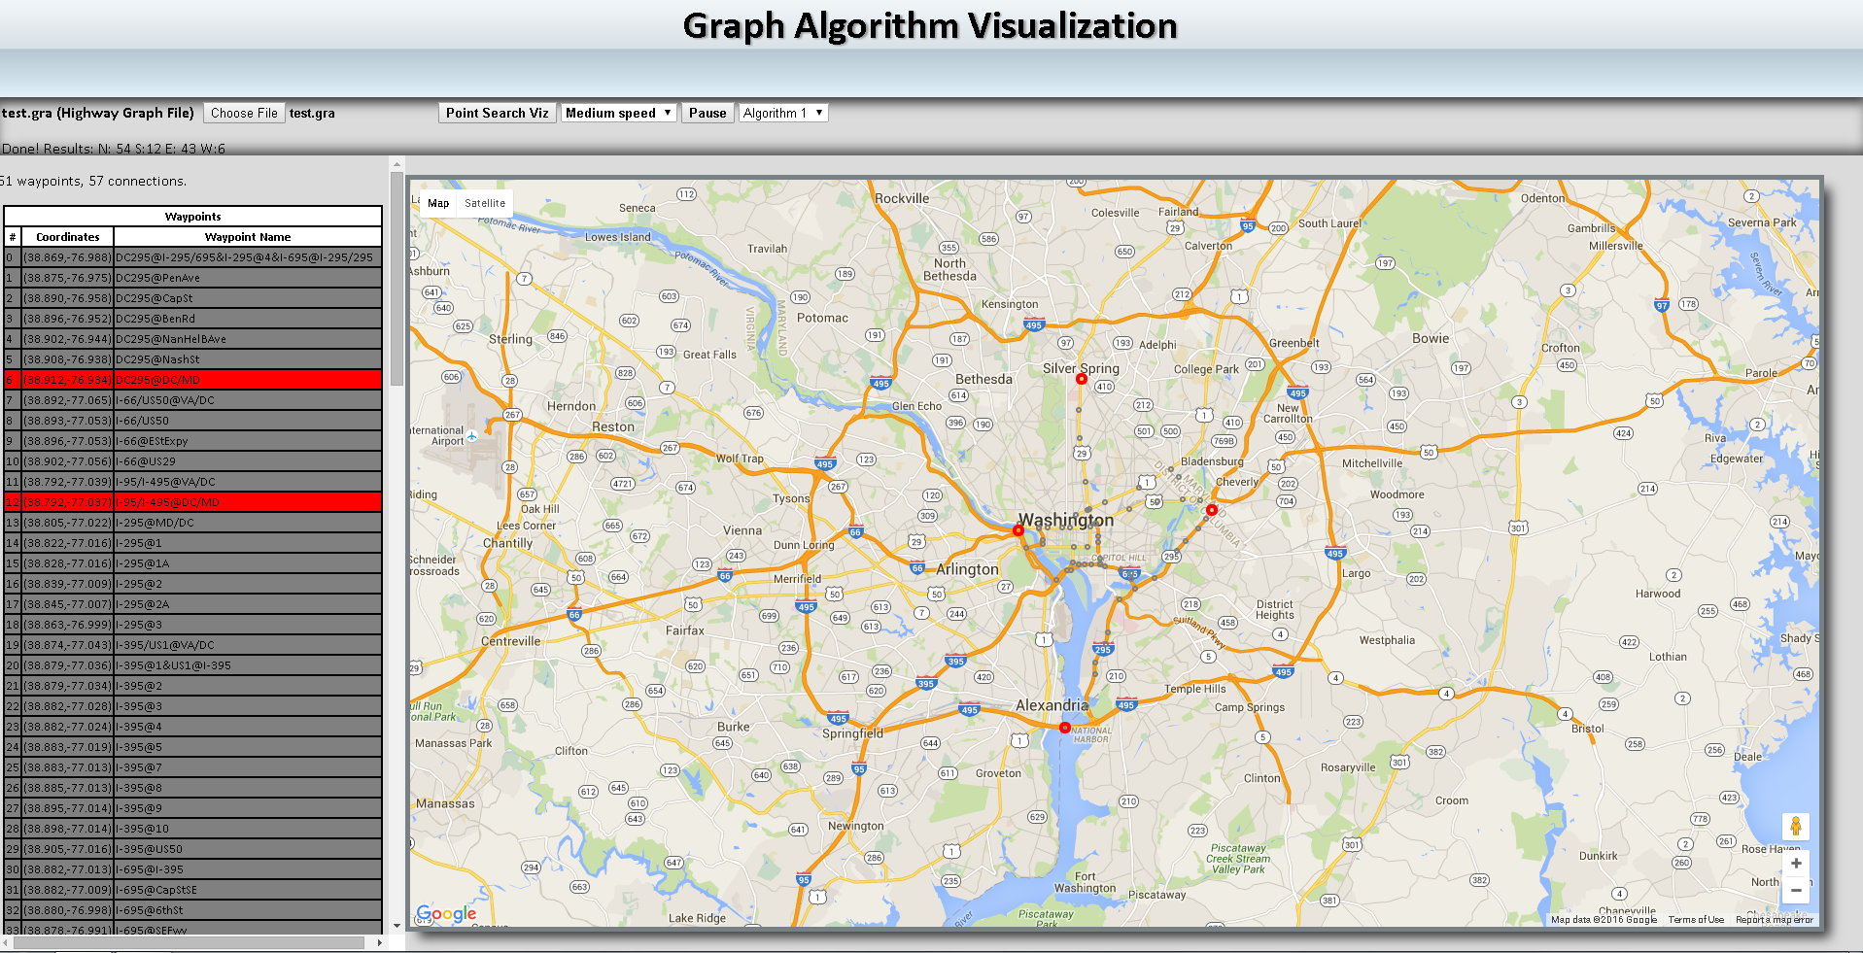
Screen shots

Slide 9
Use case diagram

Slide 10
Class diagram

Slide 11
demo
http://10.19.50.7/~patela/SE%20Project/EduTools-master/HighwayDataExplorer/index.html
http://10.19.50.7/~patela/SE%20Project/EduTools-master/AlgorithmVisualization/extremesviz/index.html

Slide 12
Any Question???

Slide 13
THANK
YOU….!!!

